Slide 1
Jermyn Borough Council Meeting
4/16/2026

Slide 2

Meeting Agenda
MARCH 19, 2026
CALL TO ORDER
PLEDGE OF ALLEGIANCE
ROLL CALL
PREVIOUS MEETING MINUTES
TREASURE REPORT/BILLS PAYABLE
CORRESPONDENCE
SECRETARY REPORT
PUBLIC COMMENT
PROFESSIONAL REPORTS
COMMITTEE REPORTS
MS4
GARBAGE ISSUES
MEETING ATTENDEES/REQUIREMENTS/WORK SESSIONS
WEBSITE FRESHENING
SPRING PAVING
CODE OFFICER
JOHN JERMYN GRANITE WALKWAY
LETTER TO COUNTY COMMISSIONERS (DATA CENTERS)
ZONING ORDINANCE REVISION DISCUSSION
EXECUTIVE SESSION FOR LEGAL MATTERS
NEW BUSINESS
ADJOURNMENT

Slide 3
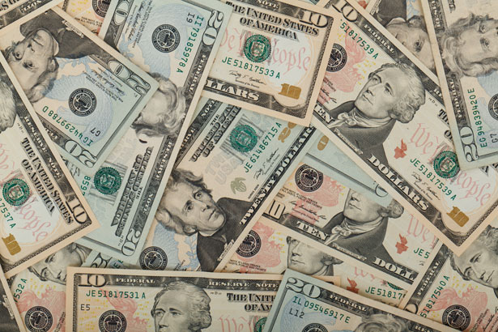
Treasurer’s report
4/16/2026
ASSETS
Checking/Savings
American Rescue Plan Fund 92,612.58
Capital Reserve - DPW 1,275.28
Capital Reserve - Police 5,154.82
Crime Watch Fund 222.69
General Fund - Community 82,893.84
General Fund - FNB 3,390.19
Holiday Lights Fund 400.59

Slide 4
Treasurer’s report
Investment - General Fund 1,184.40
Investment - Liquid Fuels 26,081.00
Investment - Paving Fund 1,196.65
Investment - Recycling 130.23
Investment - Refuse 186.60
Liquid Fuels - FNB 48,518.71
Petty Cash 194.00
Recreations Fund 21,743.76
Recycling - Community 10,141.26
Refuse Checking - FNB 95,828.05
Total Checking/Savings 391,154.65

Slide 5
Treasurer’s report
200000 · Accounts Payable 6,835.9
Long Term Debt 0

Slide 6


